Slide 1

Erica Barone Technical Evangelist – Windows & IoT @_ericabarone erica.barone@microsoft.com

Slide 2
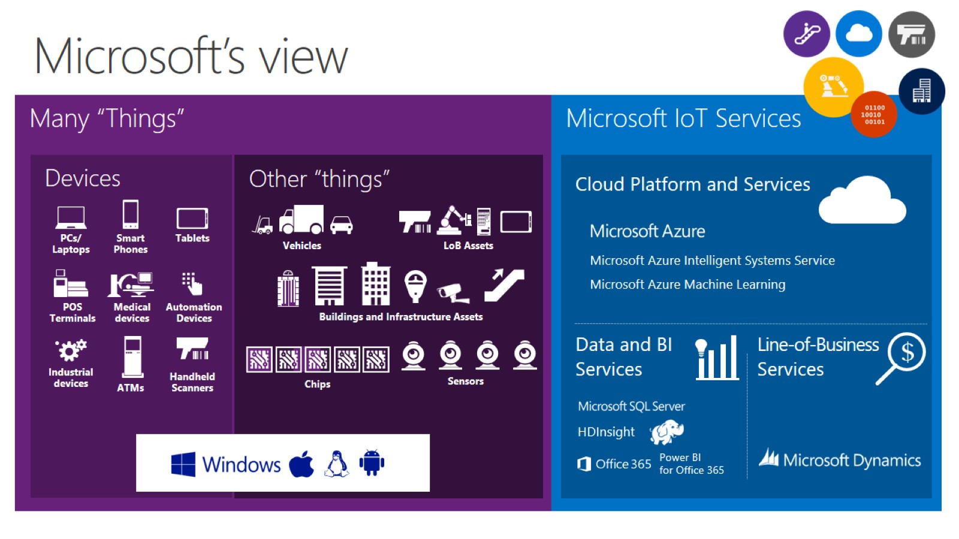

Slide 3
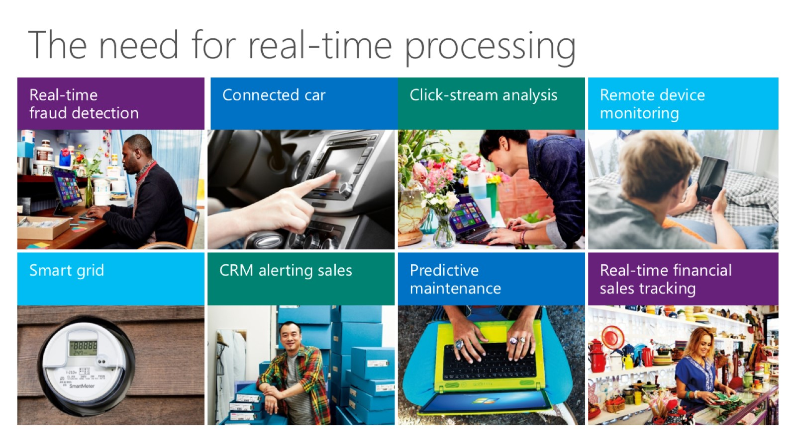
The need for real-time processing

Slide 4
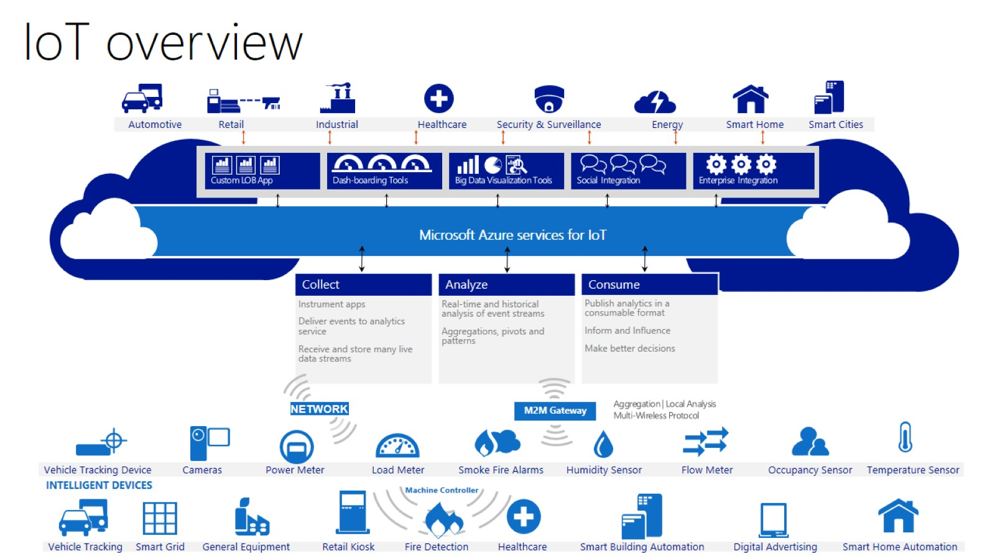
IoT overview

Slide 5
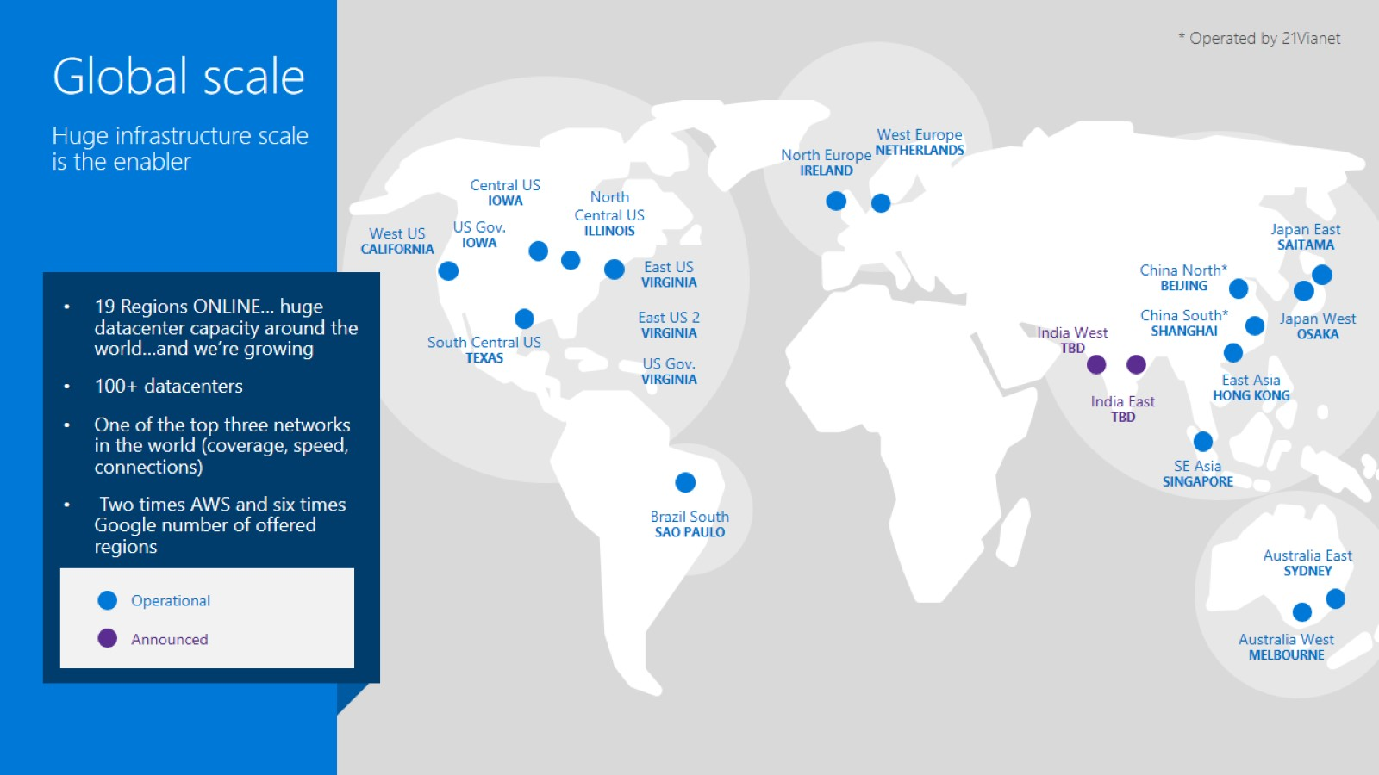

Slide 6
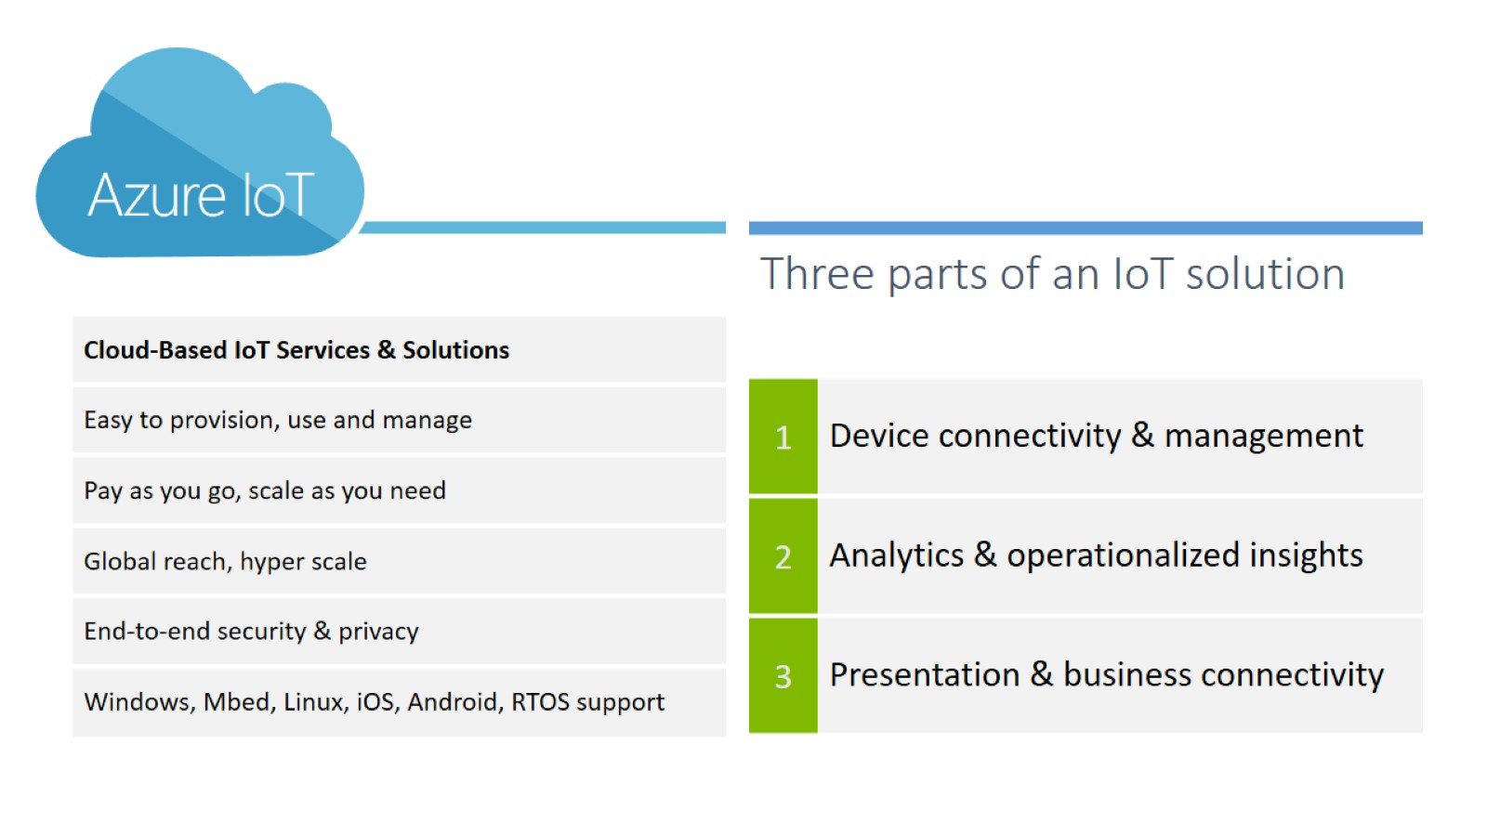

Slide 7
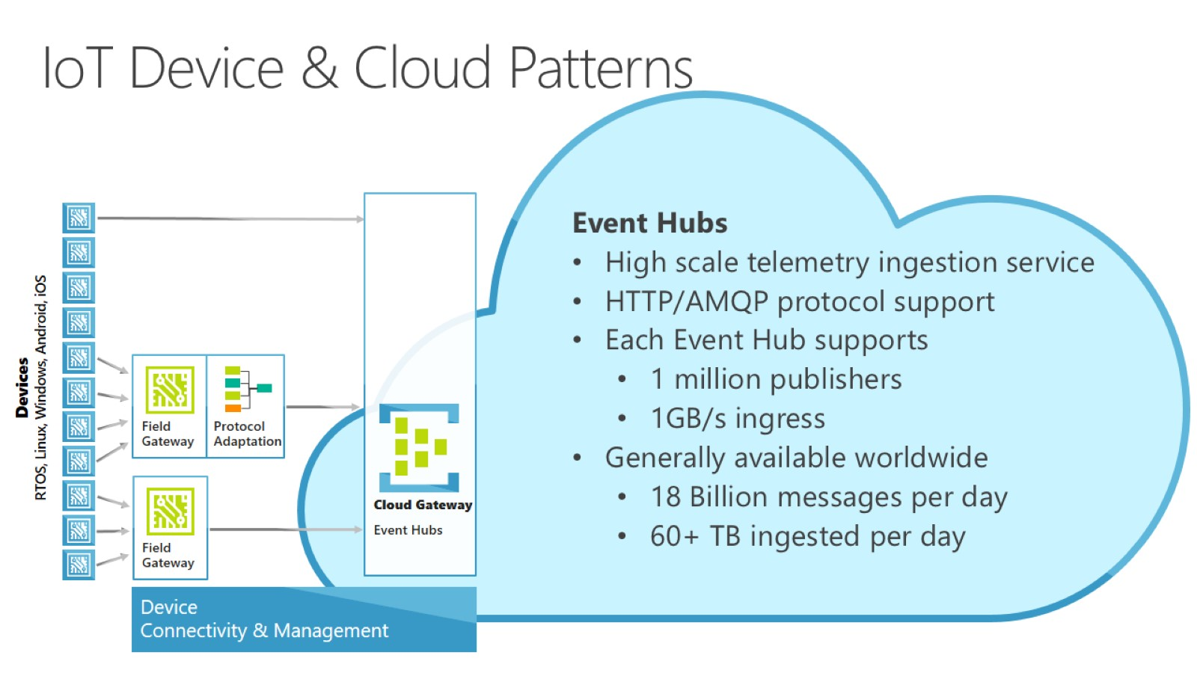
IoT Device & Cloud Patterns

Slide 8
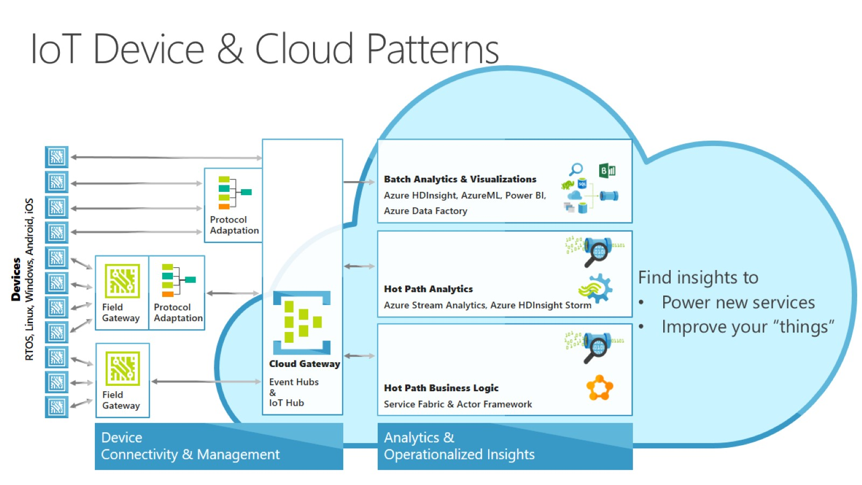
IoT Device & Cloud Patterns

Slide 9
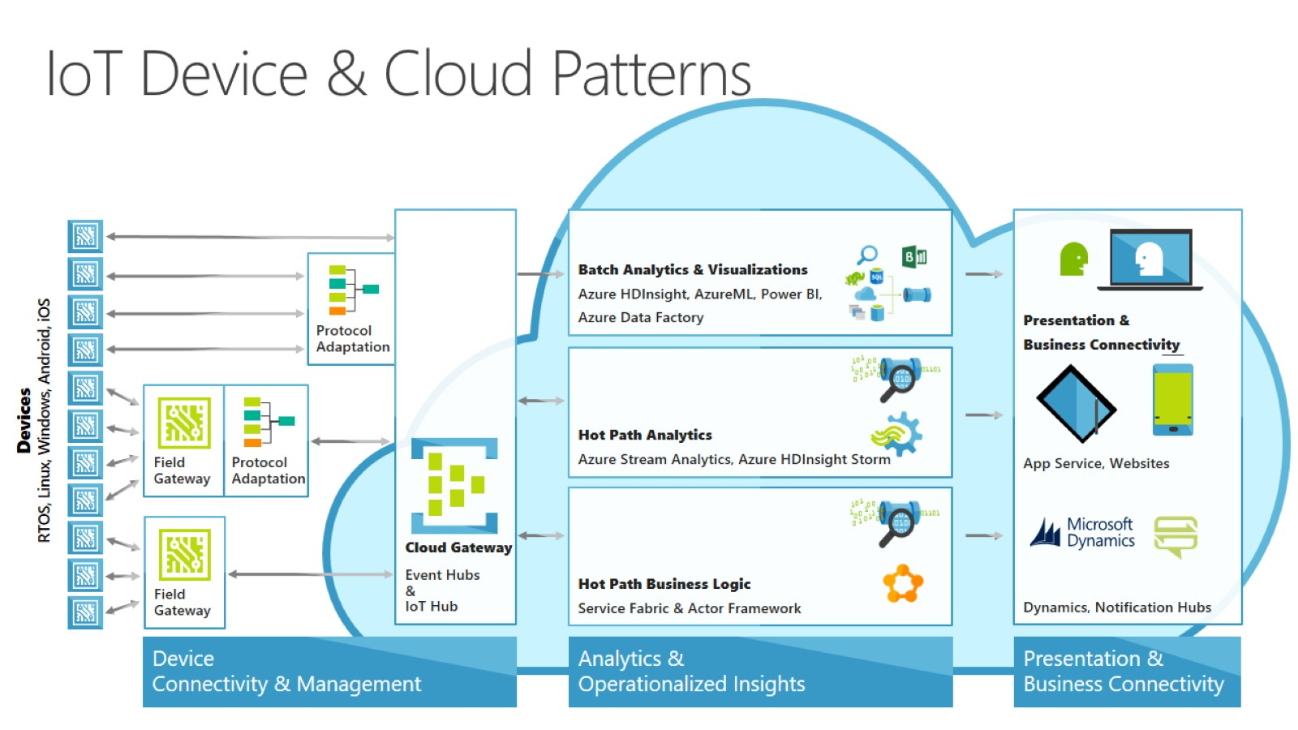
IoT Device & Cloud Patterns

Slide 10
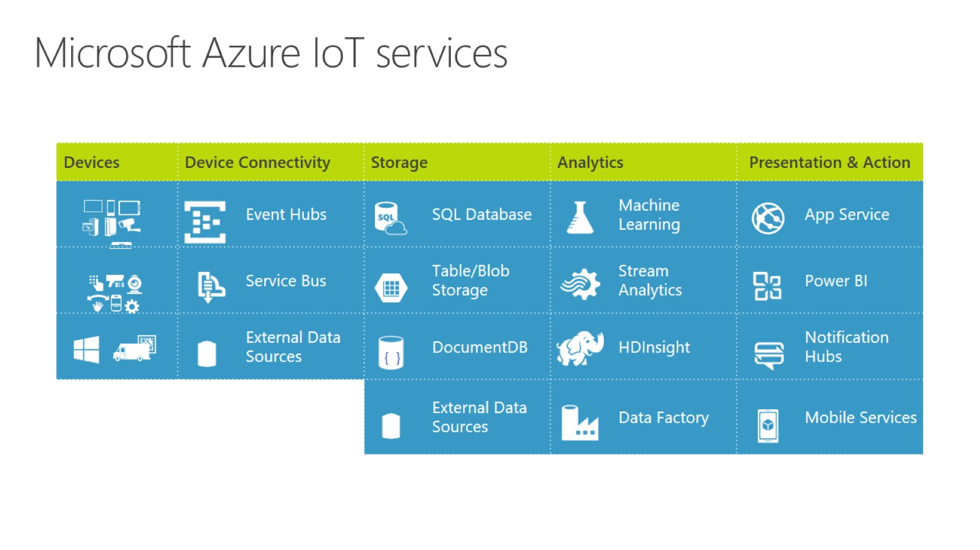
Microsoft Azure IoT services

Slide 11
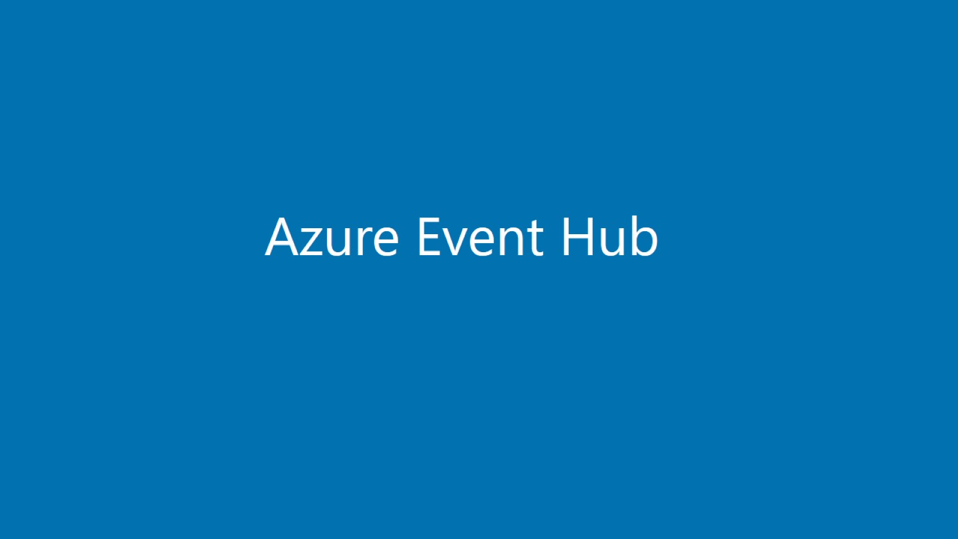

Slide 12
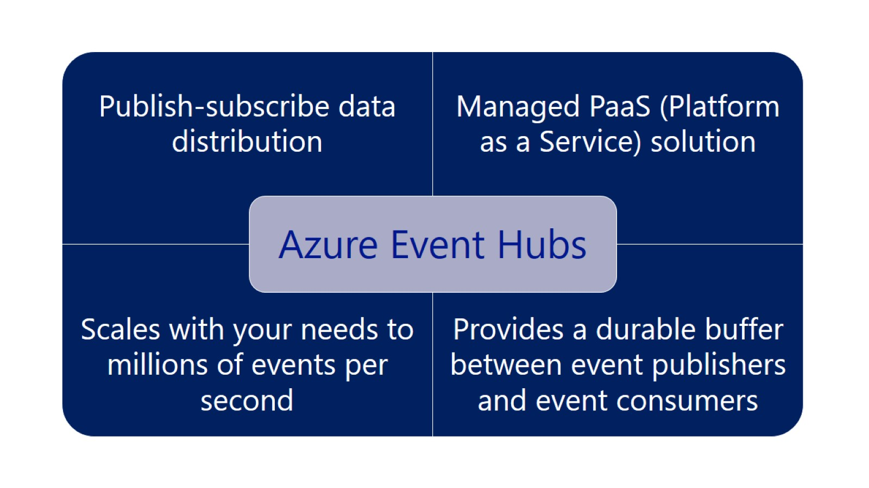

Slide 13
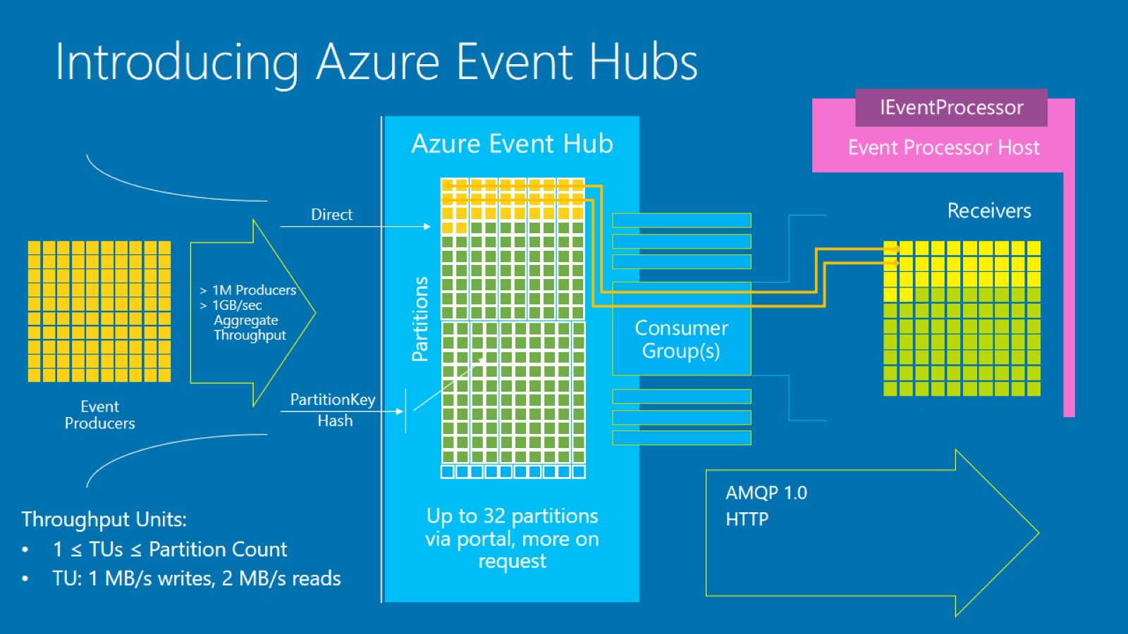
Introducing Azure Event Hubs

Slide 14
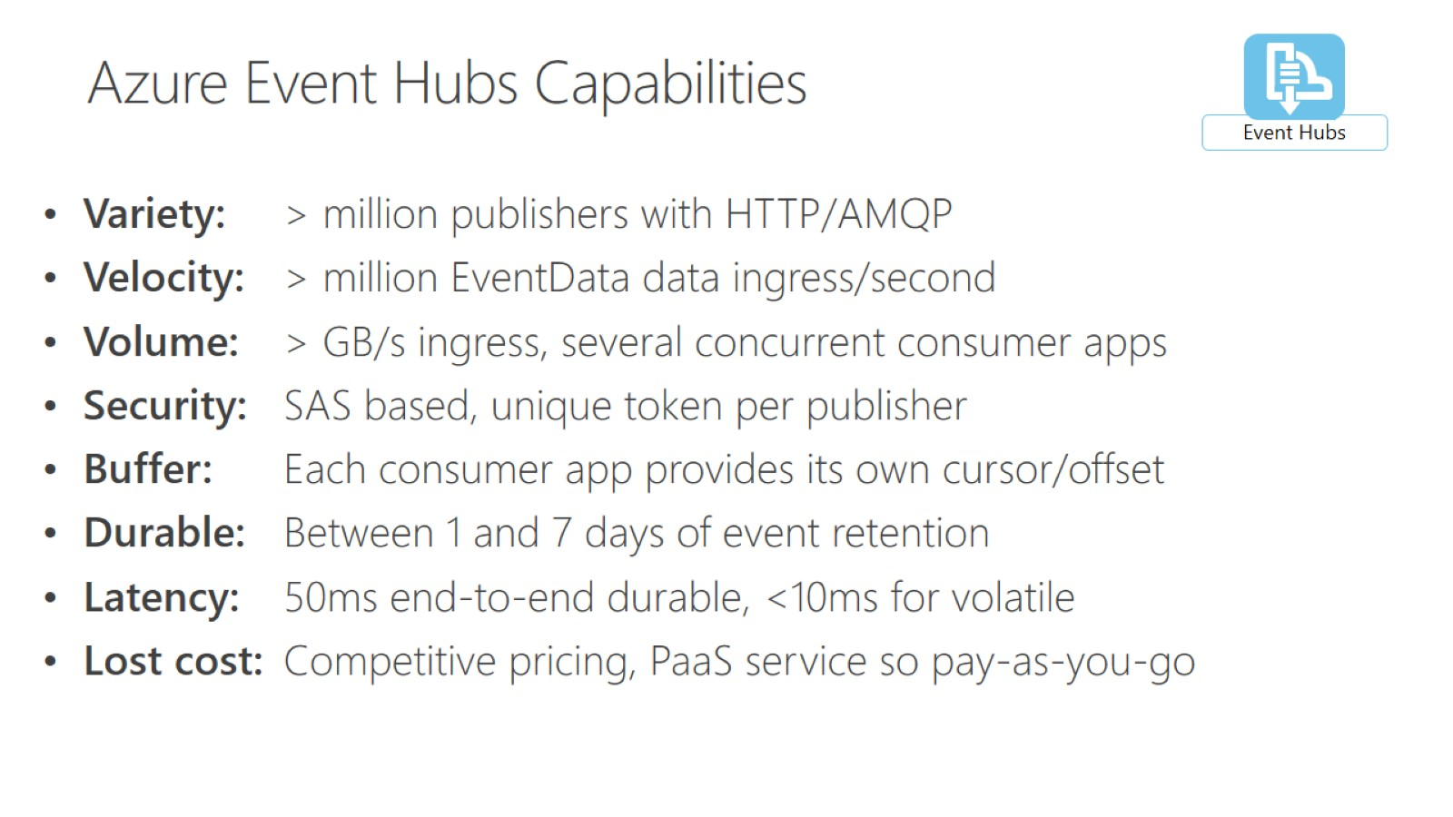

Slide 15
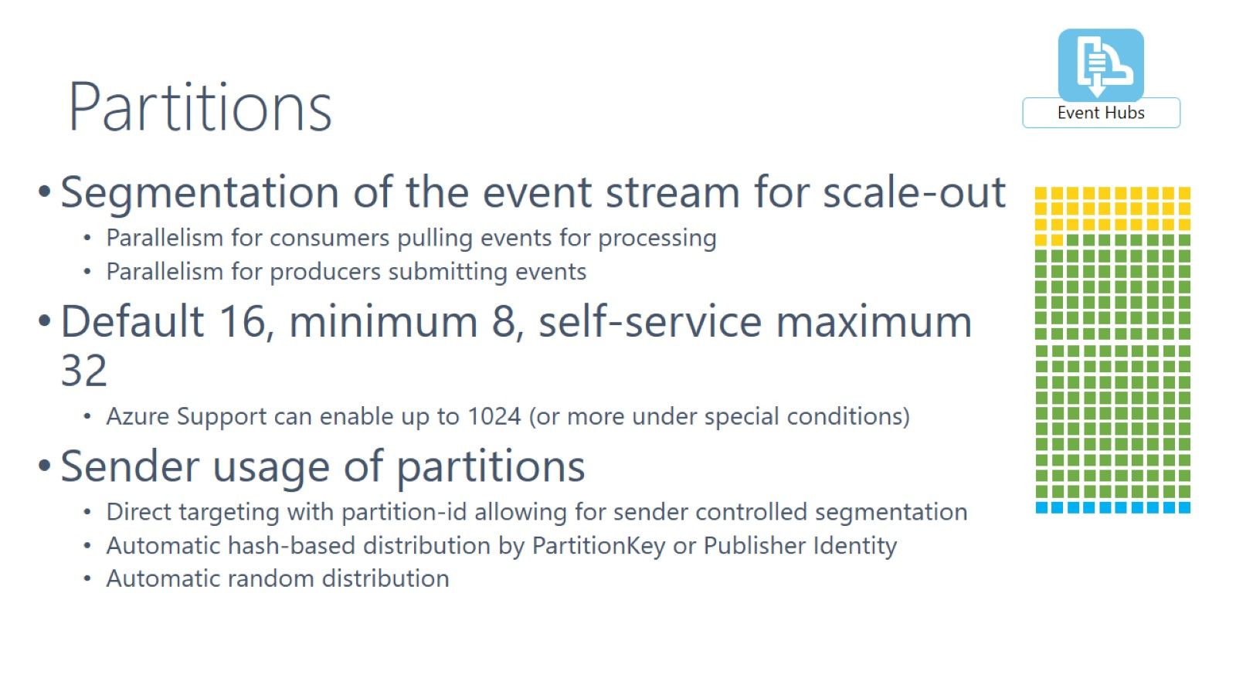
Partitions

Slide 16
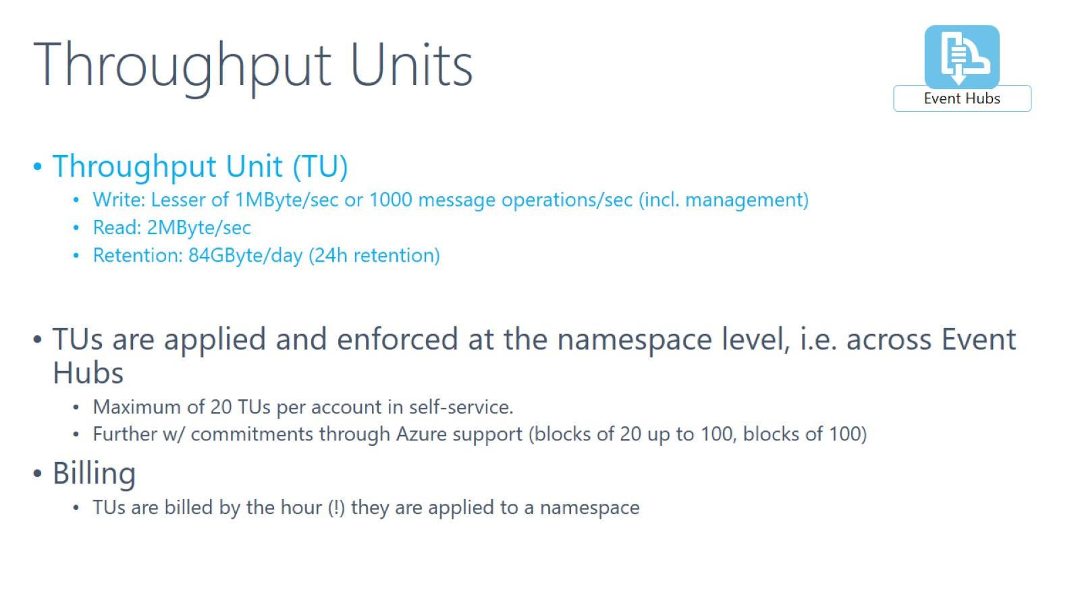
Throughput Units

Slide 17
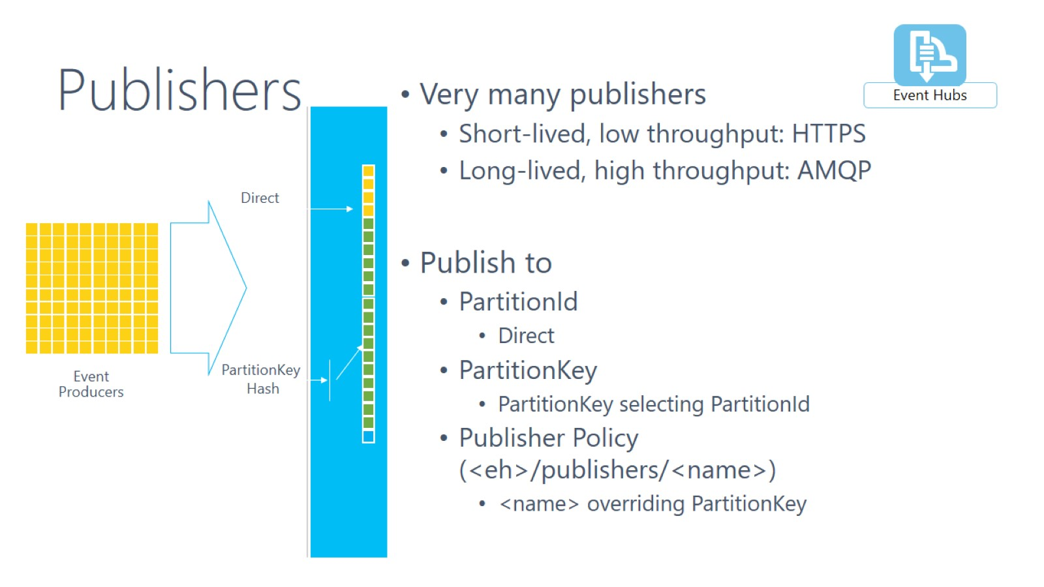
Publishers

Slide 18
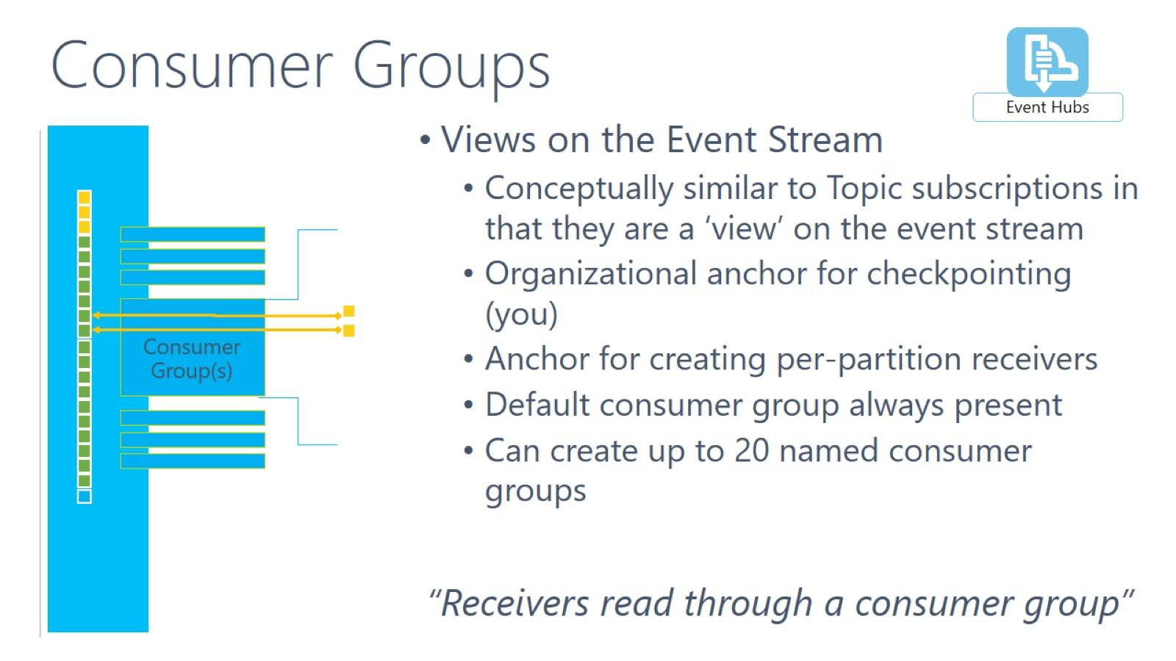
Consumer Groups

Slide 19
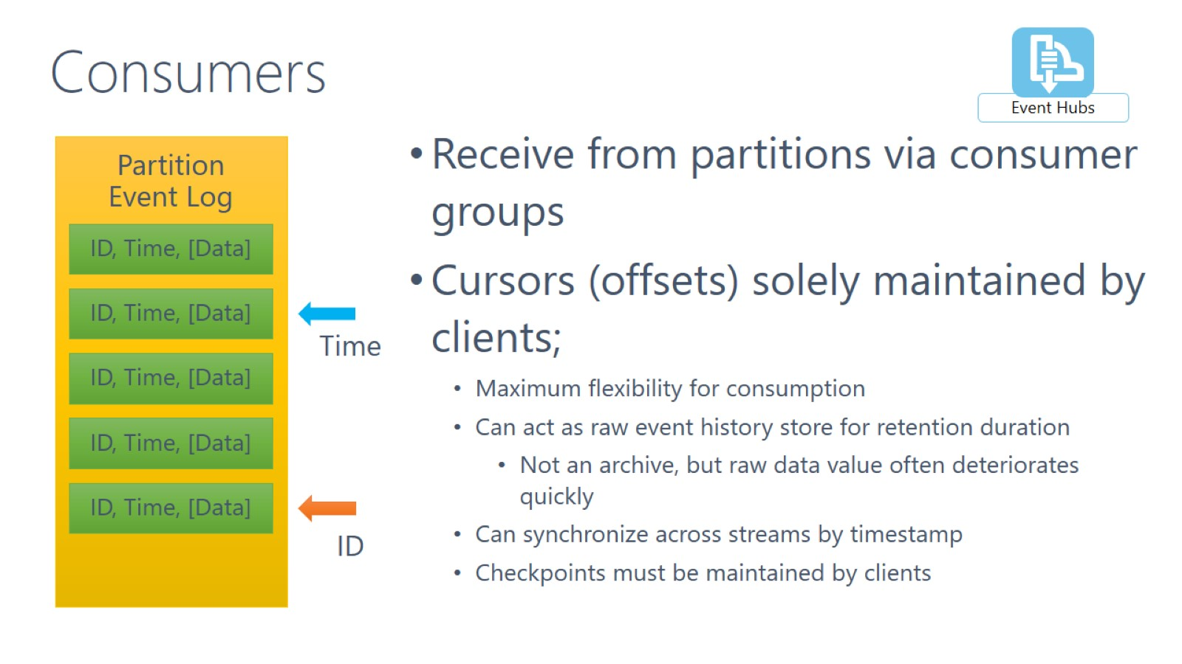
Consumers

Slide 20
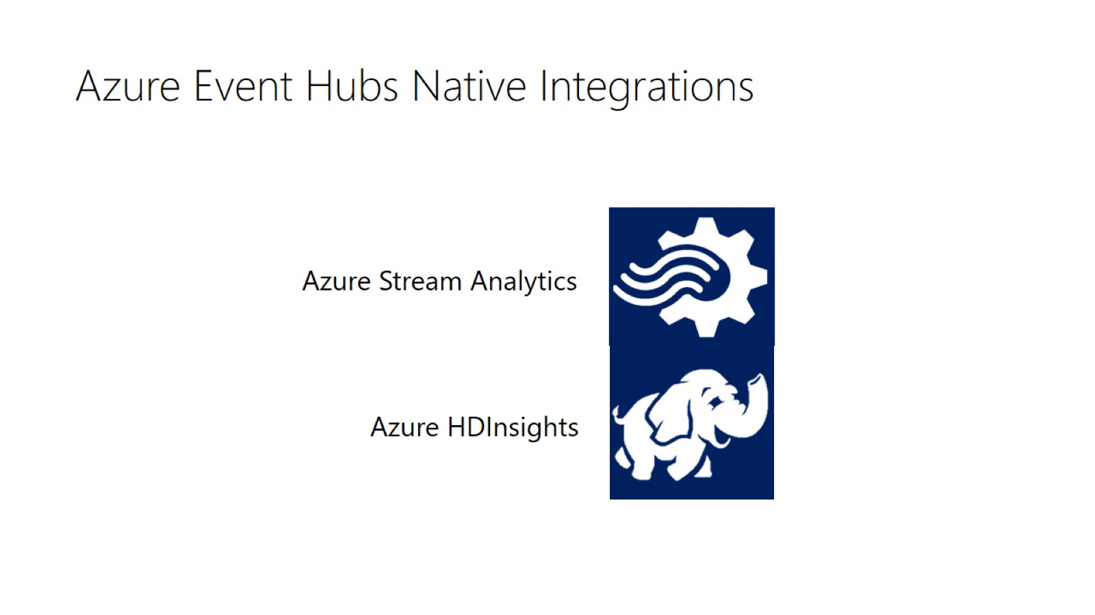
Azure Event Hubs Native Integrations

Slide 21
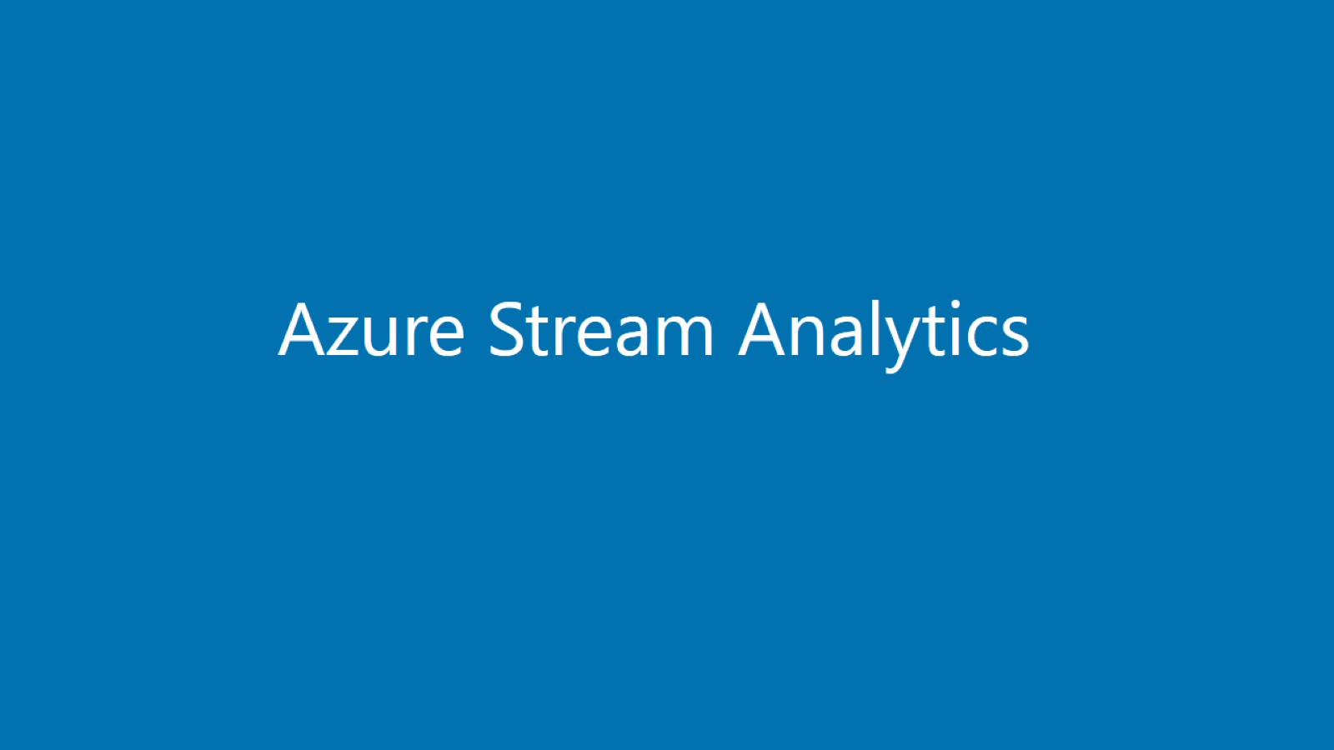

Slide 22
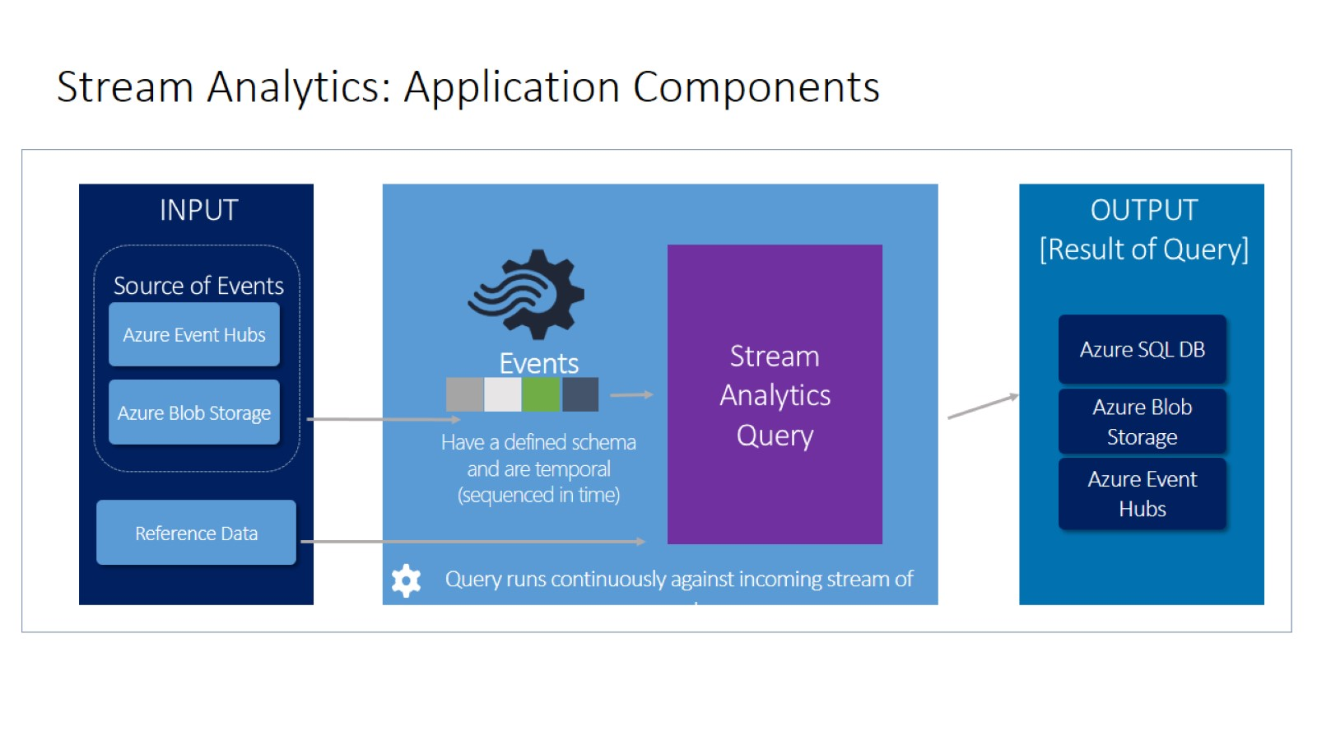
Stream Analytics: Application Components

Slide 23
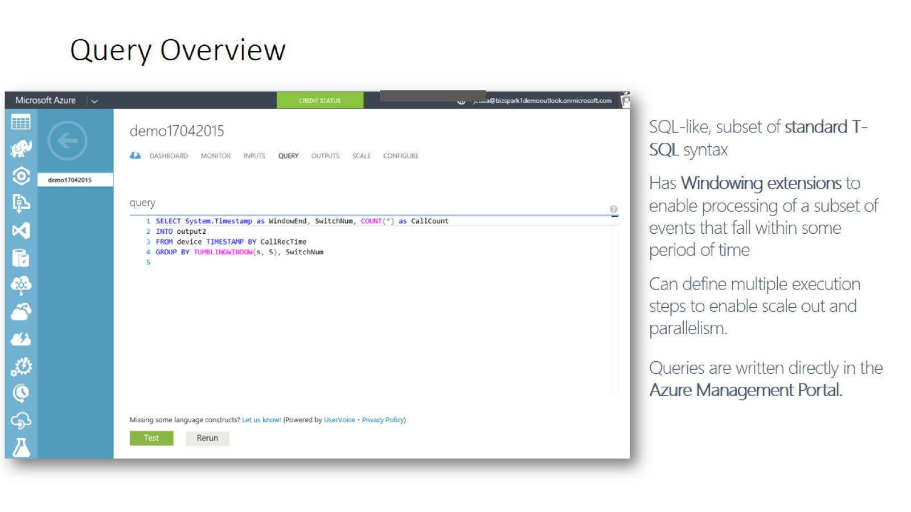
Query Overview

Slide 24
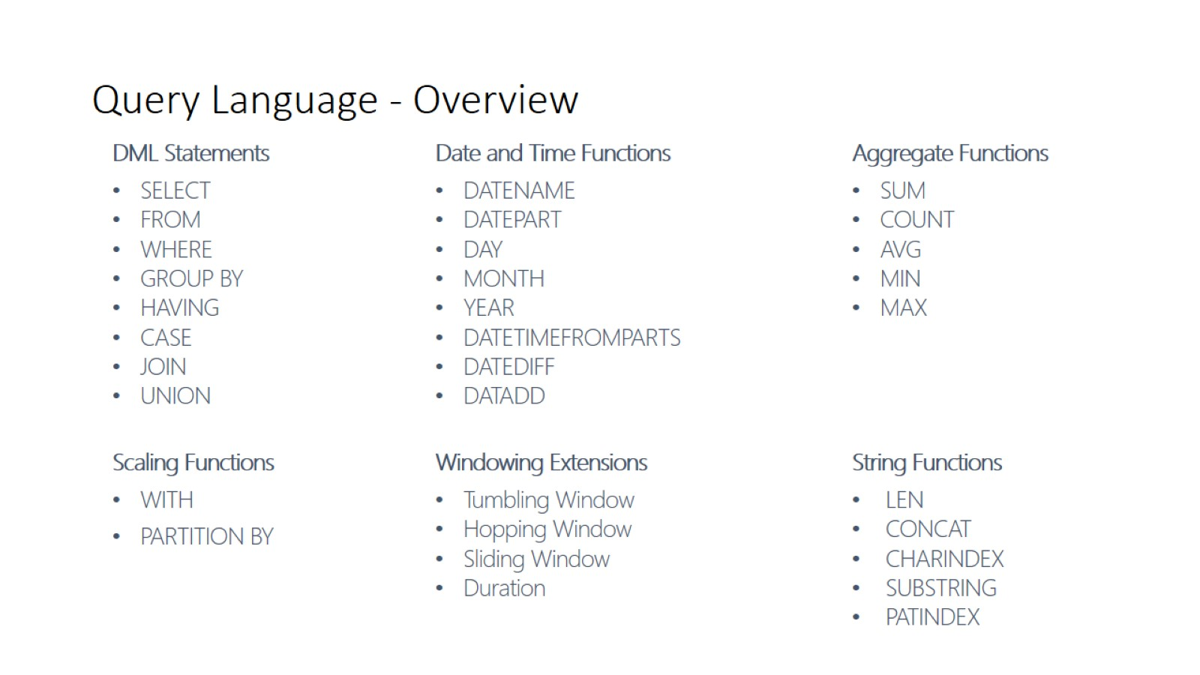
Query Language - Overview

Slide 25
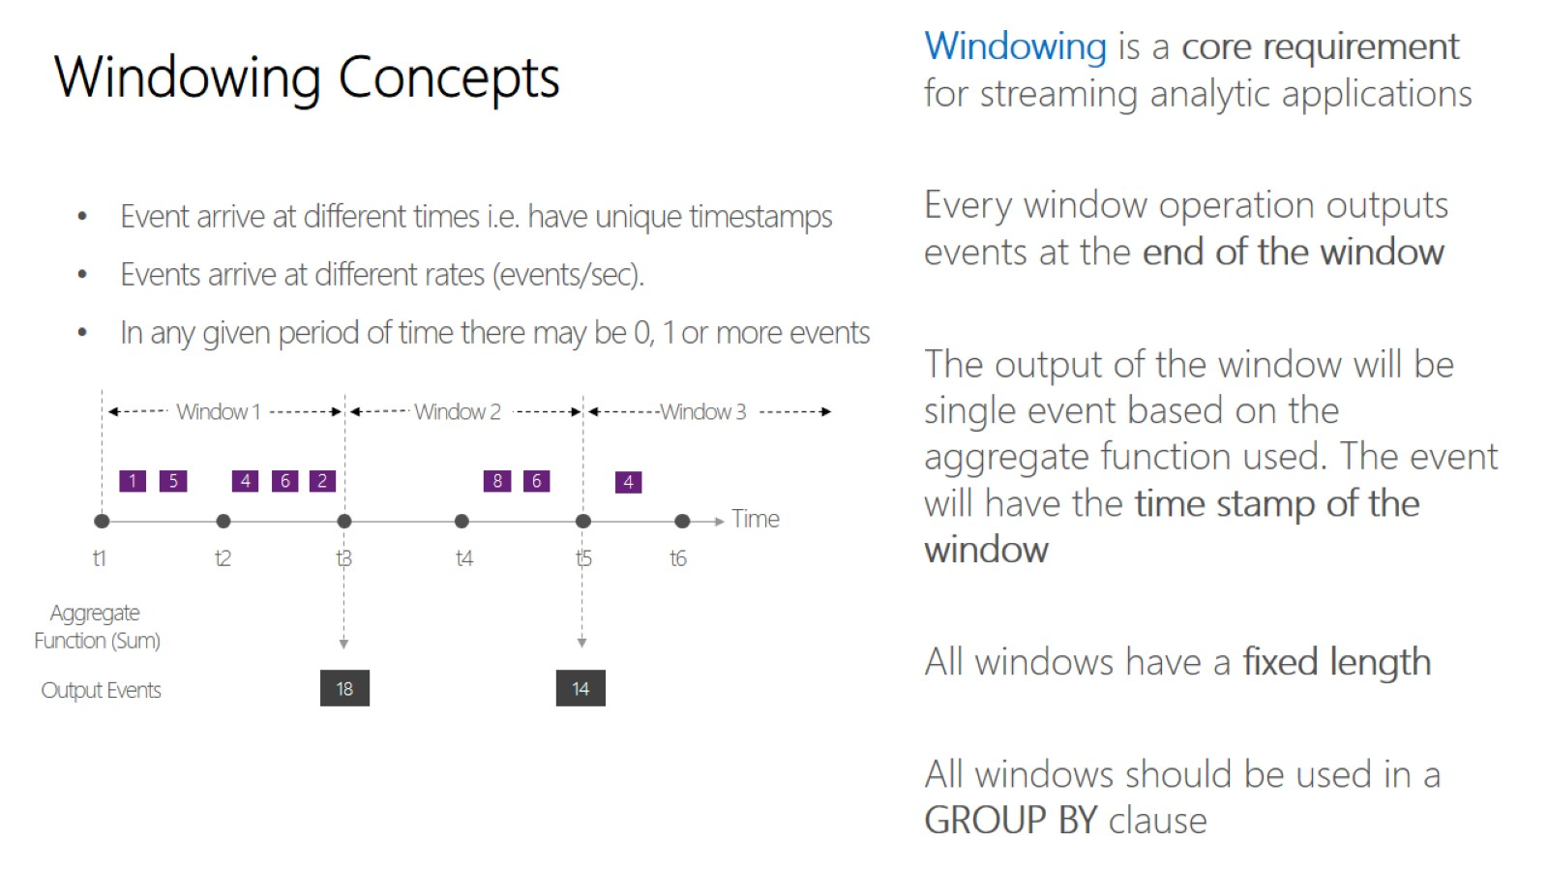
Windowing Concepts

Slide 26
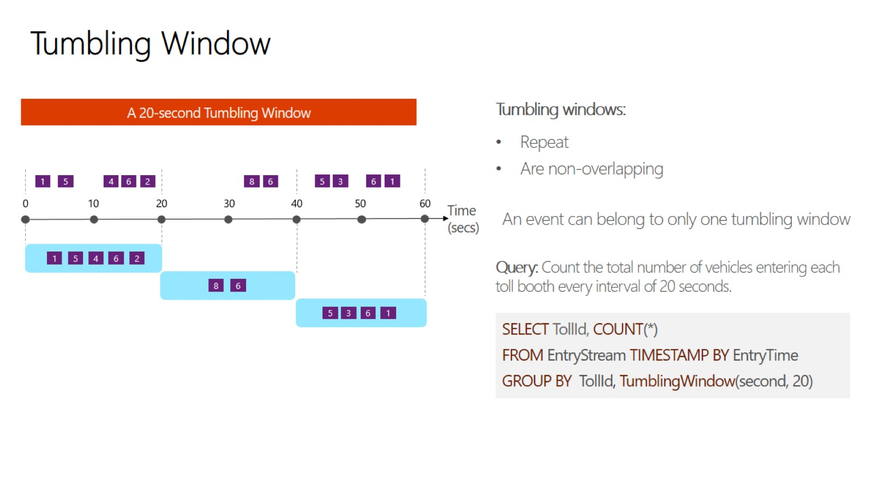
Tumbling Window

Slide 27
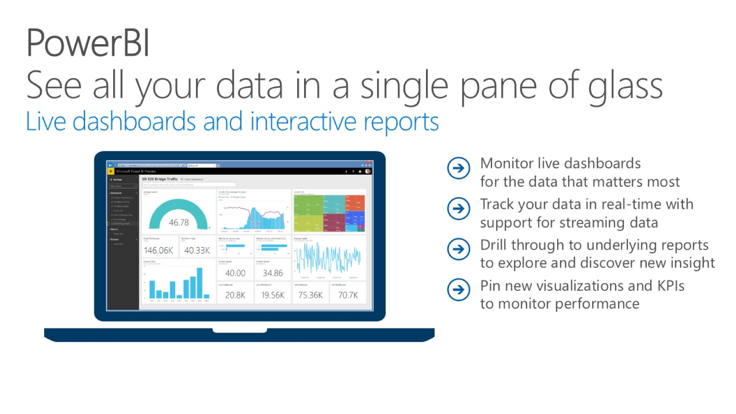
PowerBI See all your data in a single pane of glass Live dashboards and interactive reports

Slide 28
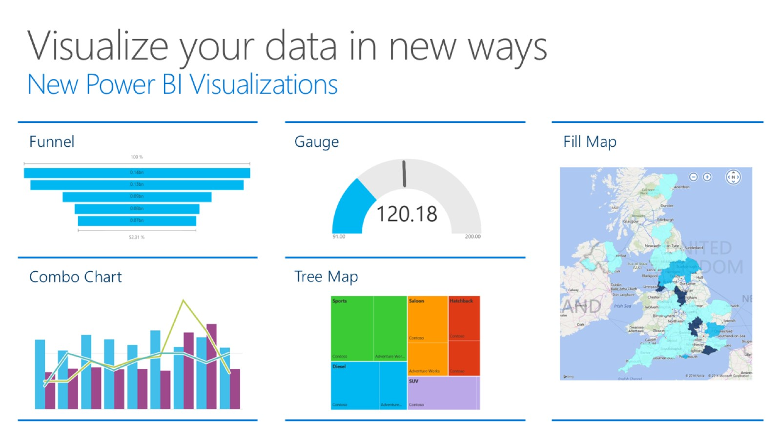
Visualize your data in new ways New Power BI Visualizations

Slide 29
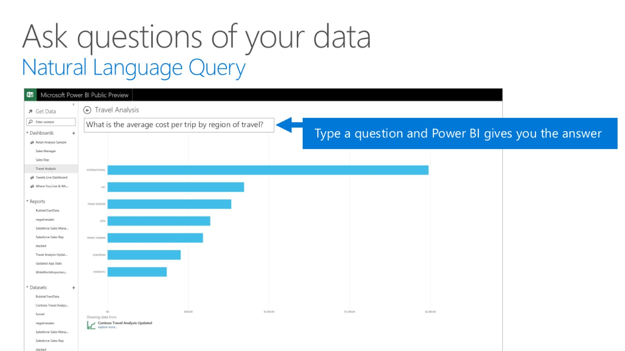
Ask questions of your data Natural Language Query

Slide 30


Slide 31


Slide 32
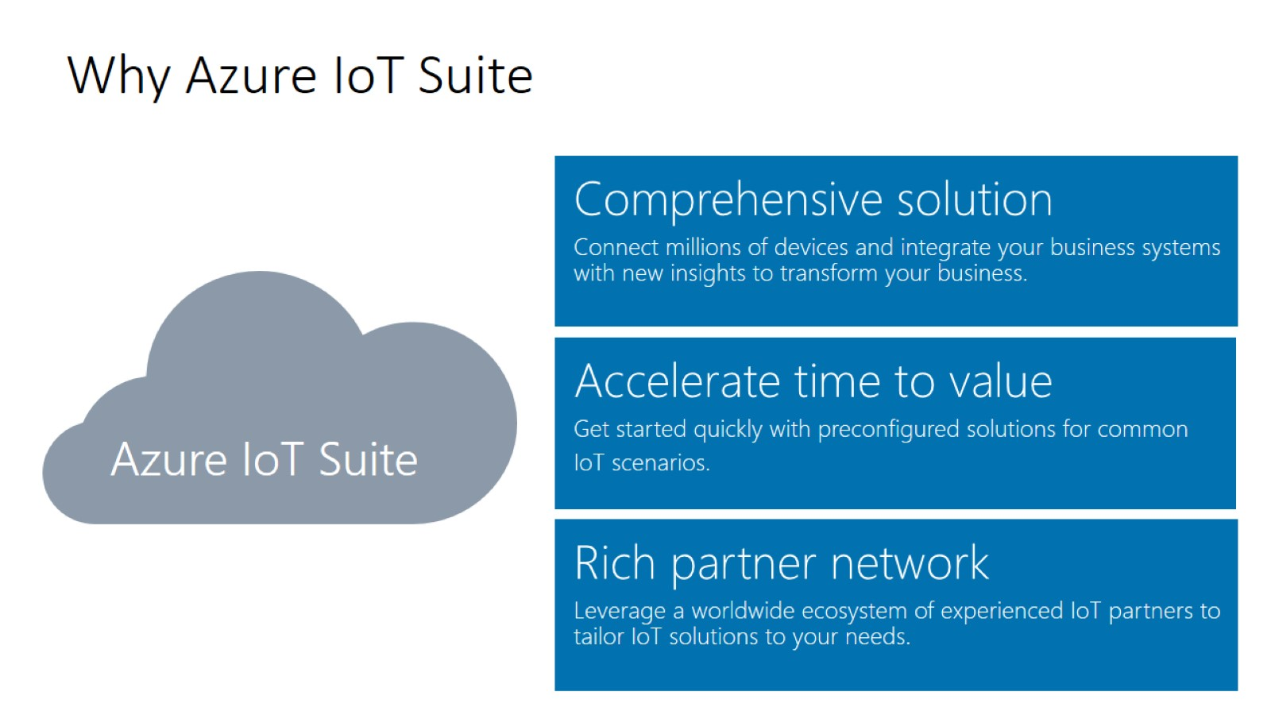
Why Azure IoT Suite

Slide 33
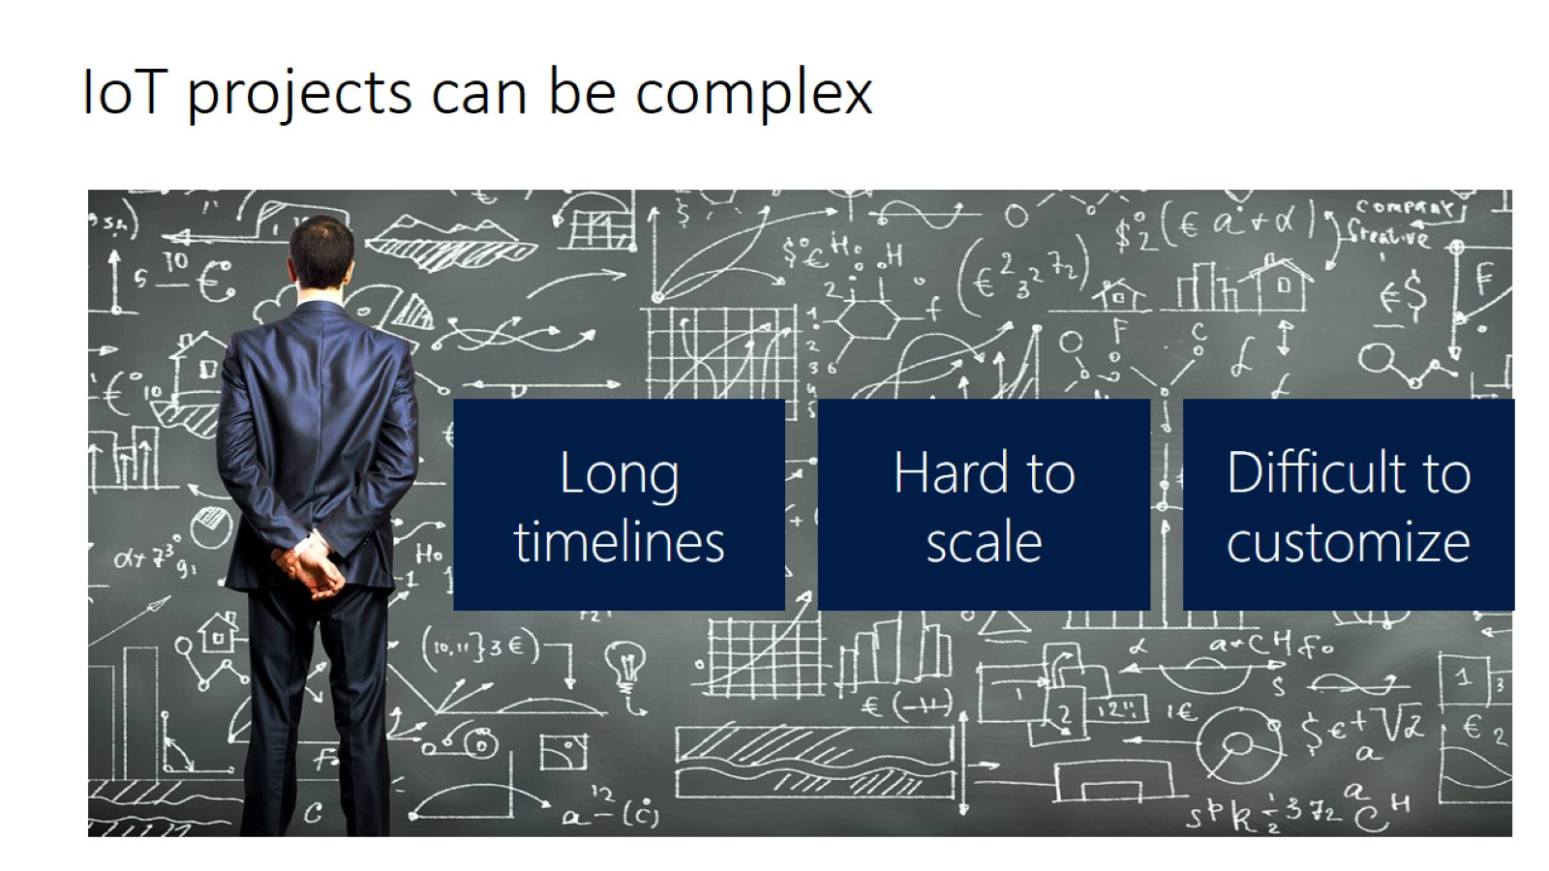
IoT projects can be complex

Slide 34
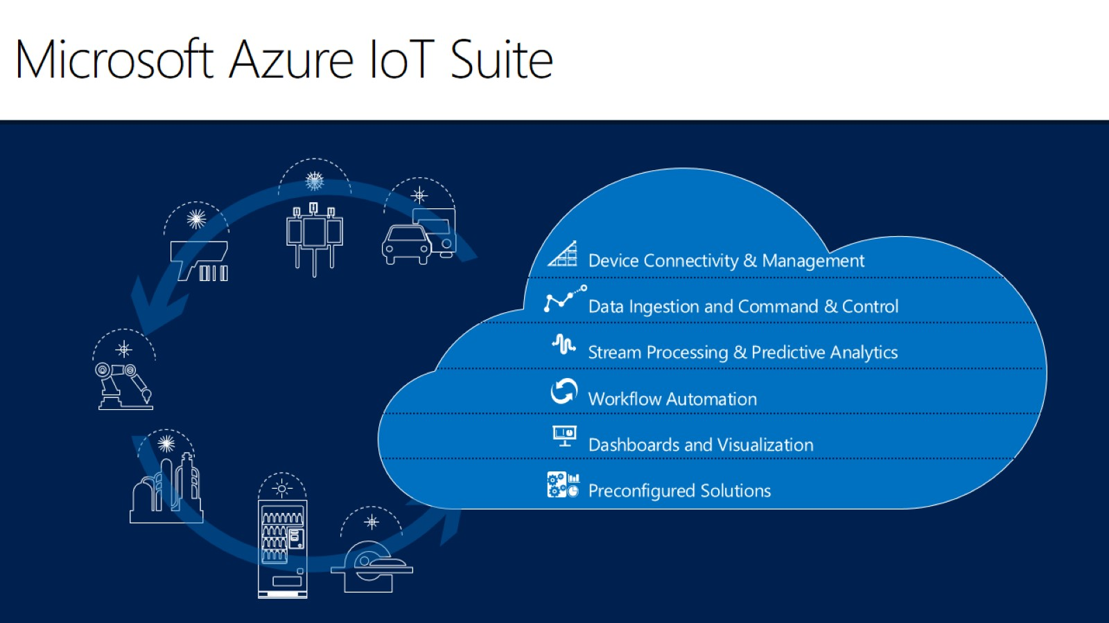
Microsoft Azure IoT Suite

Slide 35
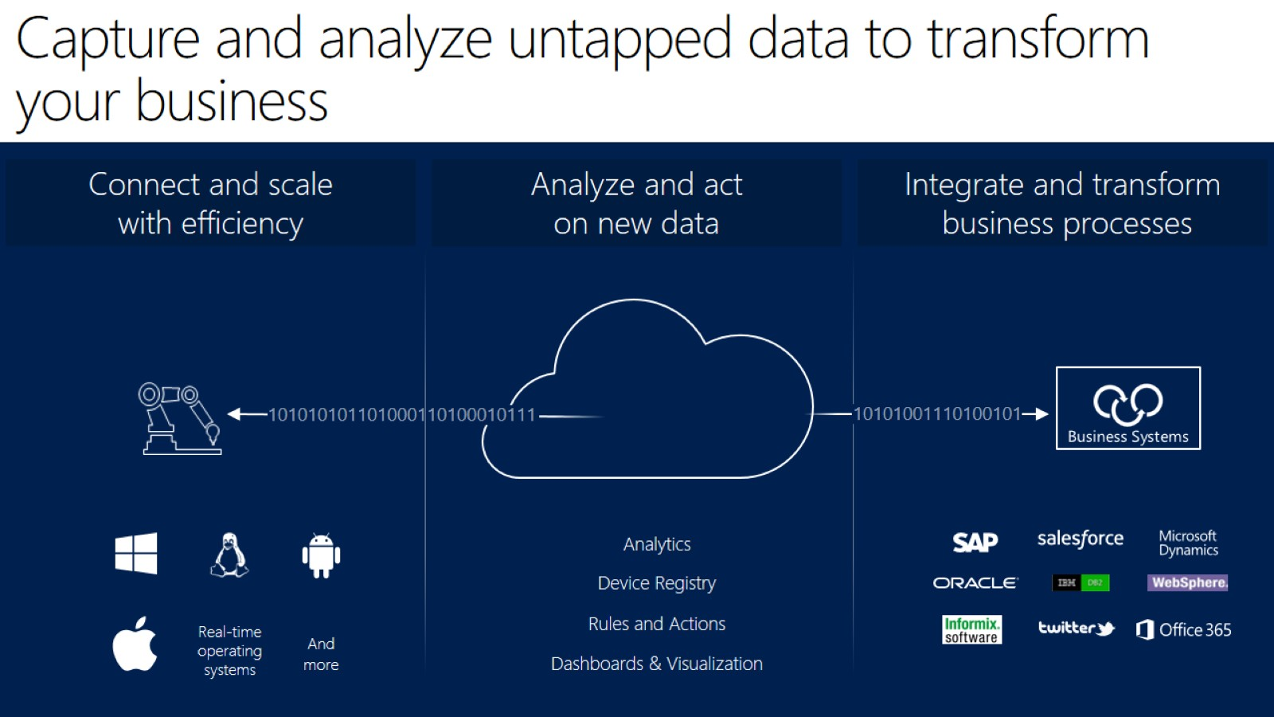
Capture and analyze untapped data to transform your business

Slide 36
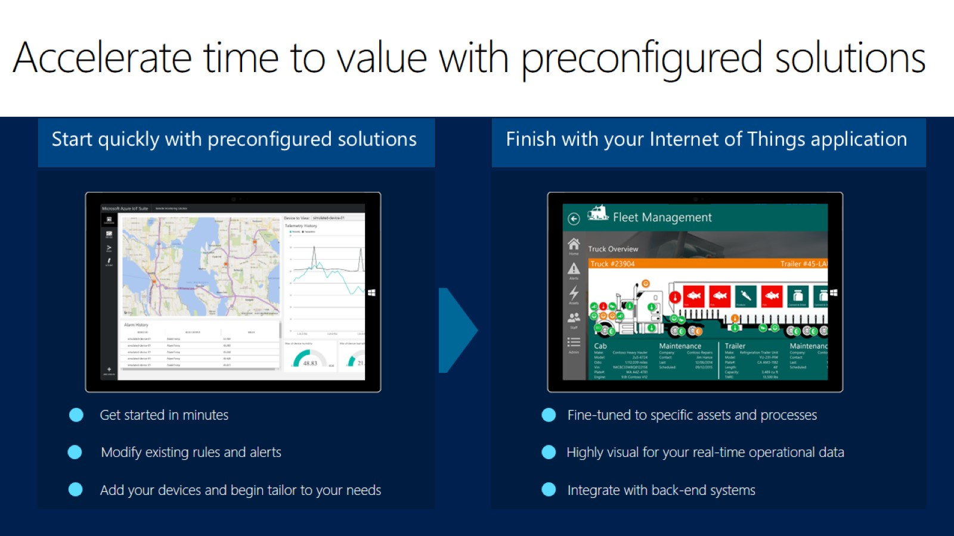
Accelerate time to value with preconfigured solutions

Slide 37


Slide 38
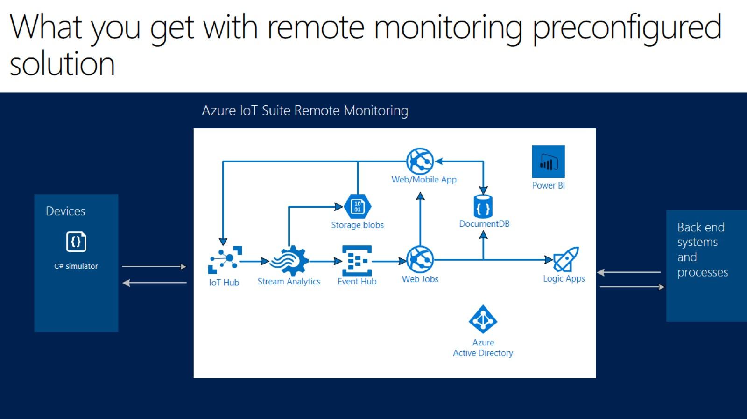
What you get with remote monitoring preconfigured solution

Slide 39


